Slide 1
Angular js 2.0 Bootcamp
Technical Trainer: Shivprasad J

Slide 2
What Exactly Is AngularJS?
AngularJS is an open source web application framework. AngularJS helps web developers create programming logic for their applications within the actual web page, and link the web application data model to backend databases and services.
This exciting program scripting language also allows UI design logic to be expressed in an HTML template file. This is particularly useful for the presentation of data.
AngularJS is a JavaScript framework for creating dynamic web apps. It expands the capabilities of an HTML template, enabling designers to turn static web pages into fully interactive web applications.
AngularJS uses the concepts of data binding and dependency injection in ways that greatly reduce the amount of code that would be required with other web programming languages.

Slide 3
Advantages of AngularJS
Some advantages of AngularJS include:
The ability to make well-organized single-page applications.
The ability to bind data to HTML.
Testable code.
Separation of component responsibilities.
Reusable components.
Greater functionality with shorter code.
Compatibility with all major browsers and mobile devices.

Slide 4
Disadvantages of AngularJS
AngularJS is not secure: Because the entire framework consists of JavaScript, the data stored in AngularJS applications are not secure.
AngularJS is not degradable: If JavaScript is disabled in the user’s browser, the application will not work.

Slide 5
The component pattern
Angular 2.0 applications use the component pattern. You may not have heard of this pattern, but it is all around us. It is used not only in software development but also in manufacturing, construction, and other fields.
In software development, components are logical units that can be combined into larger applications.
Components tend to have internal logic and properties that are shielded or hidden from the larger application.
The larger application then consumes these building-blocks through specific gateways, called interfaces, which expose only what is needed to make use of the component.
In this way, the component's internal logic can be modified without affecting the larger application, as long as the interfaces are not changed.

Slide 6
What's new that enables Angular to use this pattern?
By contrast, the newest version of Angular embraces recently emerging technologies, which make it possible to implement the component pattern more fully. These technologies include
Web Components
ES2015 (the new version of JavaScript)
TypeScript.
Let's discuss what each of these technologies brings to the mix that makes this possible.

Slide 7
Web Components
Web Components is an umbrella term that actually covers four emerging standards for web browsers:
Custom elements
Shadow DOM
Templates
HTML imports

Slide 8
Custom Elements
Custom elements enable new types of element to be created other than the standard HTML tag names such as <div> and <p>.
The ability to add custom tags provides a location on the screen that can be reserved for binding a component.
In short, this is the first step towards separating a component from the rest of the page and making it possible to become truly self-contained.

Slide 9
Shadow DOM
Shadow DOM provides a hidden area on the page for scripts, CSS, and HTML.
Markup and styles that are within this hidden area will not affect the rest of the page, and equally important they will not be affected by the markup and styles on other parts of the page.
Our component can use this hidden area to render its display. So, this is the second step in making our component self-contained.

Slide 10
Templates
Templates are repeatable chunks of HTML that have tags that can be replaced with dynamic content at runtime using JavaScript.
Many JavaScript frameworks already support some form of templating. Web Components standardize this templating and provide direct support for it in the browser.
Templates can be used to make the HTML and CSS inside the Shadow DOM used by our component dynamic. So, this is the third step in making our component.

Slide 11
HTML Imports
The final standard that makes up Web Components is HTML imports.
They provide a way to load resources such as HTML, CSS, and JavaScript in a single bundle.
Angular does not use HTML imports. Instead, it relies on JavaScript module loading.

Slide 12
Angular Modules
Components are the basic building block of an Angular application. But how do we then organize these building blocks into complete applications?
Angular modules provide the answer to this question.
Angular Modules enable us to combine our components into reusable groups of functionality that can be exported and imported throughout our application.
Each Angular application will have one or more modules that contain its components. Angular has introduced NgModule as a way to conveniently specify the components that make up a module.
Every Angular application must have at least one of these modules—the root module.

Slide 13
The basic steps to building Angular applications
To sum up: at a basic level, you will see that to develop applications in Angular, you will do the following:
1. Create components.
2. Bundle them into modules.
3. Bootstrap your application.

Slide 14
Setting up a development server
Install Node.js from http://nodejs.org/.
Create a root folder “Samples” wherever you like. Start the command prompt and select the “Samples” as your working folder.
Install the following tools with npm:
npm init --y
npm install core-js --save
npm install reflect-metadata --save
npm install zone.js --save
npm install rxjs --save
npm install @angular/core --save
npm install @angular/common --save
npm install @angular/compiler –save

Slide 15
Setting up a development server
npm install @angular/platform-browser –save
npm install @angular/platform-browser-dynamic –save
npm install @angular/router –save
npm install @angular/forms –save
npm install @angular/http –save
npm install systemjs –save
npm install bootstrap –save
npm install jquery –save
npm install typescript –save-dev
npm install typings –save-dev
npm install lite-server –save-dev
npm install concurrently –save-dev
npm install gulp –save-dev
npm install gulp-util –save-dev
npm install yargs –save-dev

Slide 16
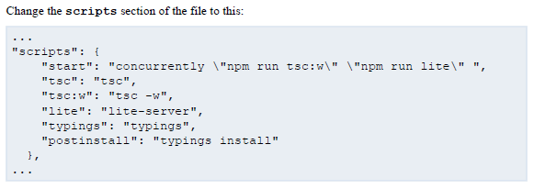
Modifying the package.json file

Slide 17
Modifying the package.json file
Remove the “main” property from the package.json file and change the following package identification properties:
……..
“name”: “angular-2-samples”,
“version”: “1.1.0”,
“description”: “This project contains the samples for angular js 2.0”,
………

Slide 18
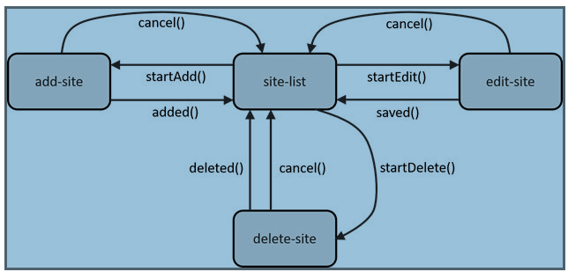
Services
A service is a class with a clear responsibility, a narrow set of operations proffered to other components

Slide 19
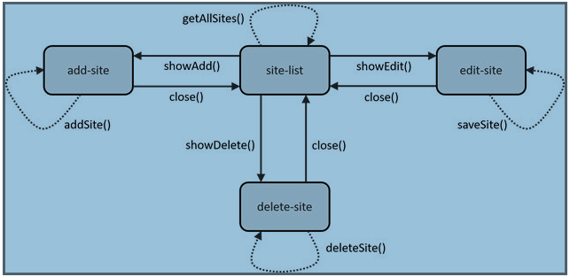
Services
Service can implement the following pattern:

Slide 20
Bindings
Angular 2.0 recommends to have one-way bindings. The following are the one- way types:
Property Binding
Attribute Binding
Class Binding
Style Binding
Event Binding

Slide 21


Property Binding
With property binding, you can pass a value to the target, but you have no way to read the target property, nor to invoke a method on the target.
The target can be an element, component or directive property.

Slide 22

Attribute Binding

Slide 23

Class Binding

Slide 24

Style Binding

Slide 25

Event Binding
Event binding pushes data in one direction: from an element to a component or directive – so in the opposite direction as property binding does.

Slide 26
Two Way Binding
Angular 2.0 suggest using one-way bindings only, it has a special two-way binding mechanism to help manage HTML forms.

Slide 27
Directives
Angular has three kinds of directives:
Components: These directives have templates, and so manage their own patch of UI. These directives are widely used.
Structural Directives: These directives change the layout of DOM either by adding or removing DOM elements. They don’t have templates. For e.g.: ngIF, ngFor, and ngSwitch.
Attributes Directives: These directives can be attached to DOM elements and they can change the appearance or behavior of elements they are annexed to

Slide 28
Two Way Binding
Angular 2.0 suggest using one-way bindings only, it has a special two-way binding mechanism to help manage HTML forms.

